Slide 1







Prevalence of commercial sexual exploitation of children in the Recife Metropolitan Region, Brazil
The Freedom Fund
19 January 2024

Slide 2
Research Team
Presenters:
Elizabeth Anderson, PhD
Senior Research & Evaluation Manager, The Freedom Fund
Carl Kendall, PhD
Professor, Tulane University, Visiting Professor, Department of Community Health, Federal University of Ceará, Brazil
Débora Aranha
Senior Program Manager, The Freedom Fund
Other team members:
Ana Maria Brito (PI), PhD
Oswaldo Cruz Foundation (Fiocruz)
Marto Leal, PhD
Federal University of Ceará
Ligia Kerr, PhD
Federal University of Ceará
Matilde Chora
The Freedom Fund
Yuki Lo
The Freedom Fund

Slide 3

1
Commercial sexual exploitation of children (CSEC)
For the present study, CSEC is defined as:
The use of children (under the age of 18) to perform sexual acts in exchange for money, goods or other favors.
Sexual acts include penetrative and oral sex, touching of the genitals or breasts, as well as performances that are sexual in nature – including pornography and erotic performances.
Photo: © Natália Corrêa / The Freedom Fund

Slide 4

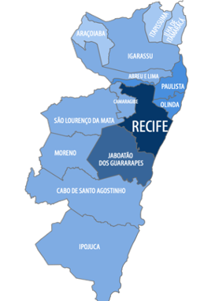





1
Why Recife?
% women in commercial sex who started commercial sex under age 18
Population (millions)
Population living
in deprivation
Metropolitan Region of Recife, Pernambuco

Slide 5
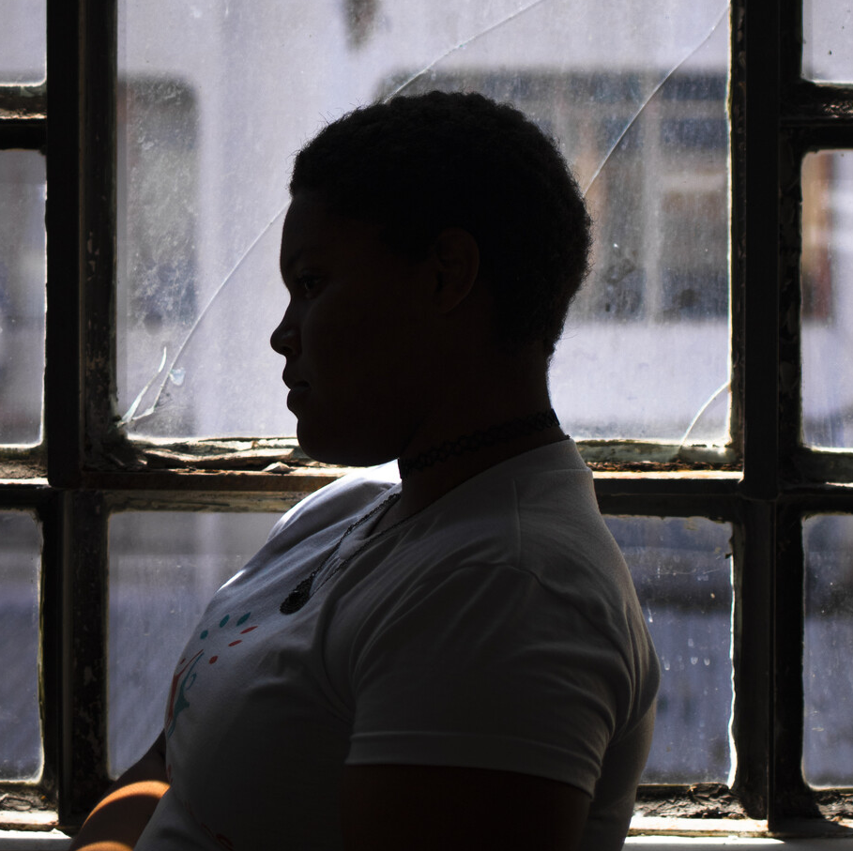
Project goals & objectives
Estimate the population of female children in the Recife Metropolitan Region who have experienced CSEC.
Examine the forms of violence, exploitation and other forms of harm that survivors are exposed to, as well as the pathways into, and out of, CSEC.
Provide data and evidence to inform child protection policies and services, to protect CSEC survivors, as well as to prevent further children falling into exploitation.
5
Photo: © Natália Corrêa / The Freedom Fund

Slide 6


Methods
Respondent Driven Sampling (RDS)
was used as the primary method to recruit a network of 602 women who completed a face-to-face survey. At the time of the survey, the women were aged between 18 and 21, had been involved in commercial sex when they were 17 or younger.
Network Scale-Up Method (NSUM)
was used as a second method as requested by the project.
A phone survey was completed by 1,002 adults living in the Recife Metropolitan Region, selected using random digit dialing.
6

Slide 7
Methods – Why RDS?
- Widely used since the 1990s to reach hidden populations, mostly for HIV surveillance :
511,000 articles with respondent driven sampling in the title*, 294,000 systematic reviews over 27 years
- Why so widely used?
    No sampling frame required – long chains reduce effects of “seeds”
    Allows participants to remain anonymous
    Peers recruit their peers (stigma, discrimination and lack of trust)
    When operationalized and analyzed correctly, provides representative estimates and confidence intervals about the population sampled
    Fit for purpose?
    Manuals (endorsed by WHO), tools (including diagnostics), & free software (RDS Analyst) available
*Google scholar Respondent Driven Sampling and survey: 1/17/24
Malekinejad M, et al. Using respondent-driven sampling methodology for HIV biological and behavioral surveillance in international settings:
A systematic review. AIDS and Behavior. 2008.12(Suppl 1): 105-130.
Johnston LG, Malekinejad M, Rifkin MR, et al. Implementation challenges to using respondent-driven sampling methodology for HIV biological
and behavioral surveillance: Field experiences in international settings. AIDS and Behavior. 2008.12(Suppl 1): 131-141.
7

Slide 8
Methods – Why RDS?
- We took advantage of the development of RDS to apply the newest tools
    Gile-SS (sequential sampling) to improve calculation of weights and and for population size estimation
    MacLaughlin visibility imputation to address an important assumption in RDS about recruitment
- We explored the most common issues for RDS:
    Convergence of values for our variables of interest
    Bottlenecks for recruitment
8

Slide 9
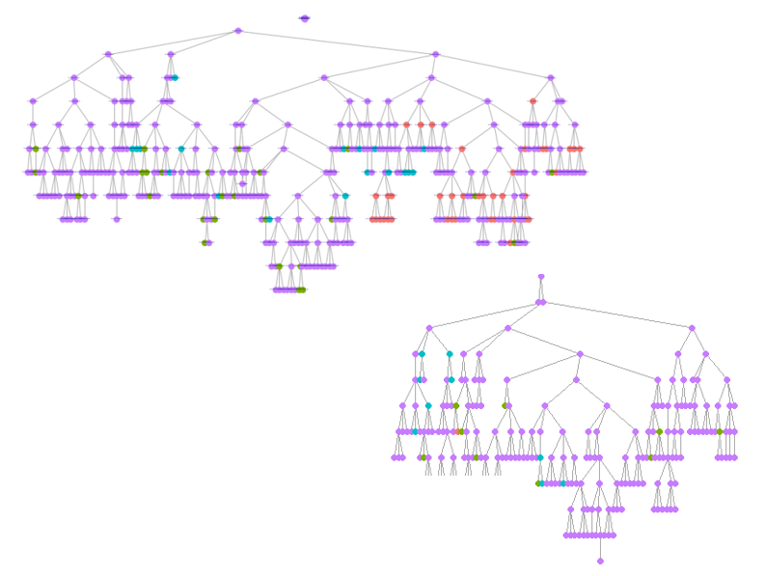
Diagnostic Tools: Recruitment trees
Recife
Olinda
Other area
No information
9

Slide 10
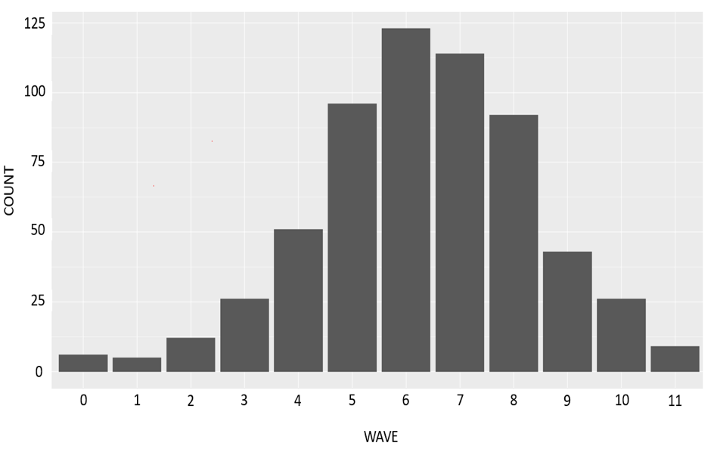
Diagnostic Tools: Recruits by waves
10

Slide 11
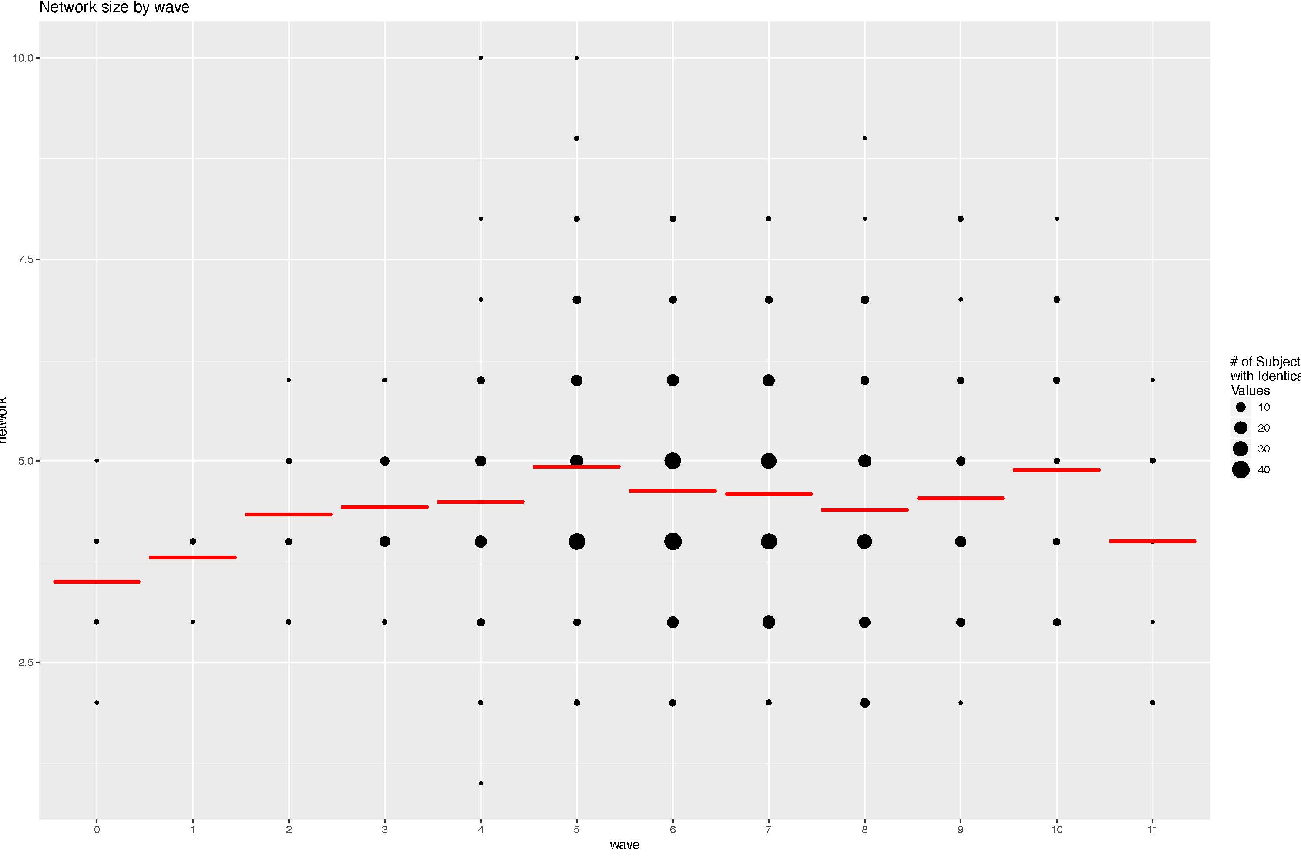
Diagnostic Tools: Scatter plot of network size by wave
11

Slide 12
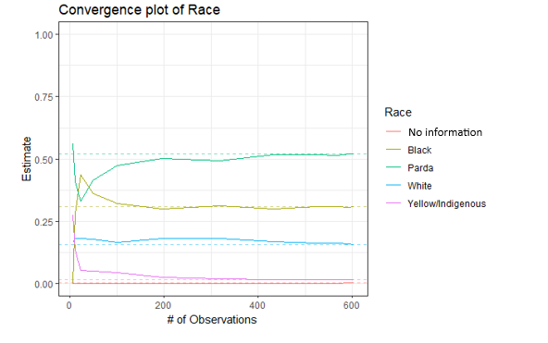
Diagnostic Tools: Convergence plot of Race
12

Slide 13
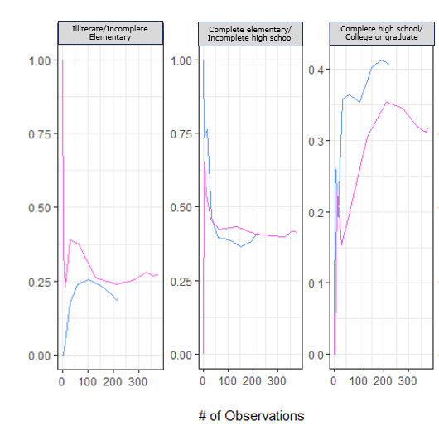
Diagnostic Tools: Bottleneck plot (Education)
13

Slide 14
Findings
> Participants’ experience during childhood
51.6% of participants had monthly household income of R$1,000 (~US$190) or less
44.7% lived in family with single mother
37.3% main guardian worked as a caregiver for the elderly, domestic worker or daily labourer
5.1% lived in an institution during childhood/adolescence
3.8% lived in an improvised, temporary shelter
1.1% of participants’ main guardian worked in commercial sex
39.3% witnessed frequent episodes of domestic violence at home
38.3% reported having first sexual intercourse before the age of 14
21.2% reported experiencing sexual violence at least once
14

Slide 15
Findings
> First entry into CSEC
> Reasons for entering into CSEC
100.0% of participants exchanged sex or other sexual acts for money, favors or other goods when they were under 18 years old
80.0% were still enrolled in school when they were first involved CSEC
22.4% were under 15 years old when they were first involved in CSEC
58.4% were approached by someone they knew
45.9% received R$100 (~US$19) or less the first time they were involved in CSEC
Economic pressure
Having access to consumer goods
Maintain basic needs
Lack of training/ qualifications
Influenced/forced
Pregnancy
Family abandonment
15

Slide 16

Findings
”My grandmother was
responsible for me.
Because she is elderly, I told her
I would help her. . . At 16, 17,
there was no other way for me
to earn, no one to help us.
So I entered this life.”
- CSEC Survivor in Recife
”My family was
threatening to throw me
out of the house, I would go
without eating. I thought I’ll try
[commercial sex] at least one
time - to see if it’s any good. . .
I was 13 and it [the sex]
was with a friend.”
- CSEC Survivor in Recife
16

Slide 17
Findings
> Forms of coercion and control
> Violence and dependency
31.6% felt they had been lied to, with the sexual exchange being different from that agreed
24.7% reported feeling pressured to engage in commercial sex
12.5% understood that they would lose what they had already earned if they gave up ‘work’
11.3% had been forced to have sex with someone to pay back money that was owed
3.4% had a debt imposed on them without their consent
1.8% experienced kidnapping, confinement or immobilization associated with CSEC
Emotional abuse
Physical violence
Unable to refuse work
Police violence
Drug dependency during CSEC
Alcohol dependency during CSEC
17

Slide 18
Findings
> Access to services while in CSEC
Healthcare establishments (such as family doctors)
Sexual health clinics
Social assistance / welfare
Employment programs
Street outreach services
NGOs that provided food
Specialized assistance for CSEC
18

Slide 19

Prevalence Estimate
Network Scale-Up Method (NSUM) population estimate of female CSEC survivors in the Recife Metropolitan Area
Successive Sampling–Population Size Estimation (SS-PSE) of ‘recent’ female CSEC survivors who were age between 18 and 21 at the time of the data collection
16.7%
of young women in the
Recife Metropolitan Area,
aged 18 to 21 at the
time of study, were
CSEC survivors
19,700
(interquartile range:
10,678 to 40,180)
22,600
(interquartile range:
12,712 to 44,163)
used as a prior
to calculate
19

Slide 20
Collaborative Experiences
Research advisory group
Insights from women in commercial sex, subject experts and researchers to ensure context-appropriate approaches and recommendations
Collaboration among researchers
Sharing of methodologies and findings among researchers on the subject.
Collective reflections on findings.
Identification of areas for future studies (eg online sex trafficking).
Collaboration among researchers, NGOs and government
Recognition of the relevance of the study to advance knowledge target investments.
Use of data for collective advocacy.
20

Slide 21
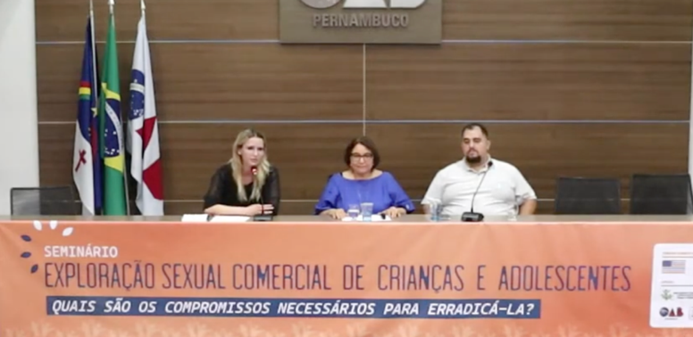
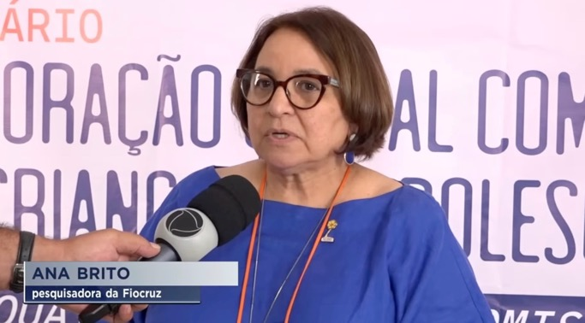
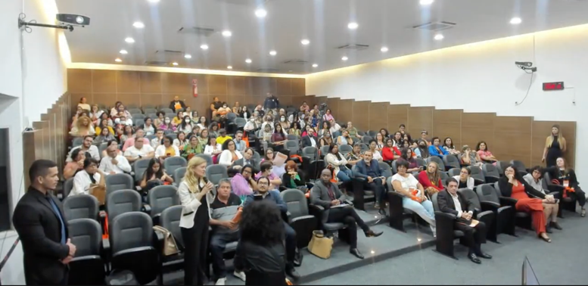

Research influence on programming
21

Slide 22
Research influence on programming
Collective advocacy
Use of data for increasing visibility and boost government responses at all levels
Advocacy for appropriate allocation of public budget
Priogramming priorities
Evidence-based prevention and early identification of CSEC and other VAC in schools and communities
Inclusion of survivors in education and job opportunities, including raising awareness of businesses (apprentice law)
Accessible, non-judgmental sexual and reproductive health interventions
Campaigns to reduce the demand in high-prevalent areas/sectors and online
22

Slide 23



Project Expansion
To reduce the prevalence of commercial sexual exploitation of children (CSEC) in the municipalities of Recife and Olinda, in Pernambuco
Goal
Outcomes
COLETIVO MULHER VIDA
CHILDHOOD
PROMUNDO
INSTITUTO ALIANÇA
Civil society and government set guidelines and targets for CSEC interventions and monitor their outcomes.
6,500 vulnerable children, including survivors of CSEC, have greater access to information, trauma-informed services, and pre-vocational education.
Local decision makers and frontline organizations use the latest available evidence to guide responses to tackle CSEC.

Slide 24
Project Expansion
Coletivo Mulher Vida
Training educators and health workers
Raise awareness among children, young people and communities
Instituto Aliança
Capacity building on assistance to survivors
Pre-vocational education and inclusion of survivors in the world of work
Childhood Brasil
Support the implementation of the protected listening law within the Protection Network and the Judicial System.
Promundo
Study on profile and motivations of perpetrators of CSEC.
24

Slide 25
Thank you!
eanderson@freedomfund.org
daranha@freedomfund.org
carl.kendall@gmail.com

