Slide 1
Estimating the Prevalence of Forced Labor in the Fishing Industry in Costa Rica
IOM Project Coordination Team
Alina Cedeño Montoya | Francesca Tabellini

Slide 2
Disclaimer: This study was funded by the United States Department of State, through the Prevalence Reduction Innovation Forum (PRIF) at the University of Georgia. The opinions, conclusions, and findings indicated in this study are solely those of the authors and do not necessarily reflect those of the United States government or the University of Georgia.​

Slide 3
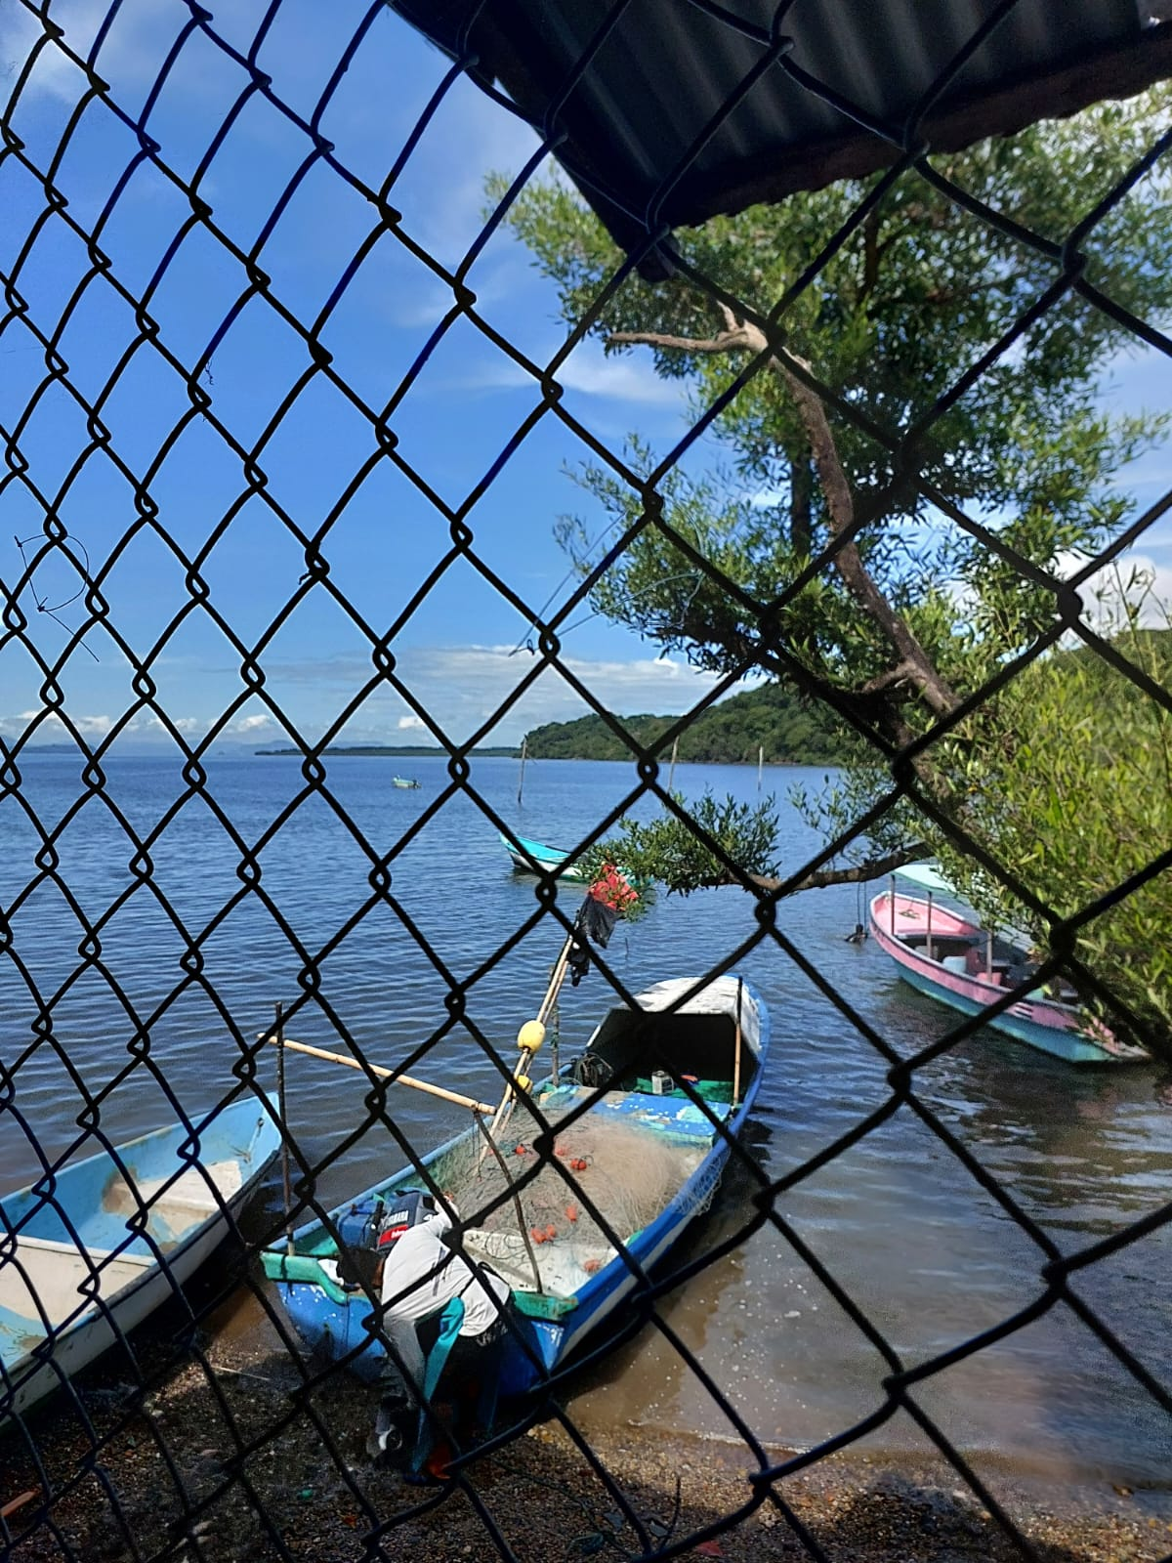
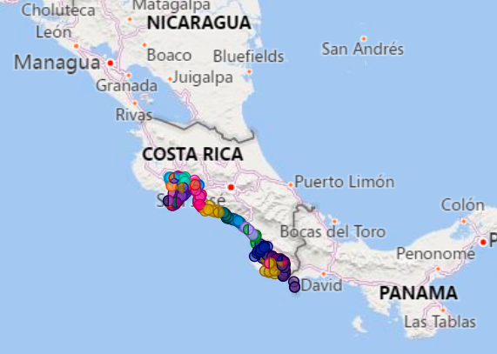
Estimating the Prevalence of Forced Labor in the Fishing Industry in Costa Rica
Academic partner: NYU
Implementing partner: IOM

Slide 4
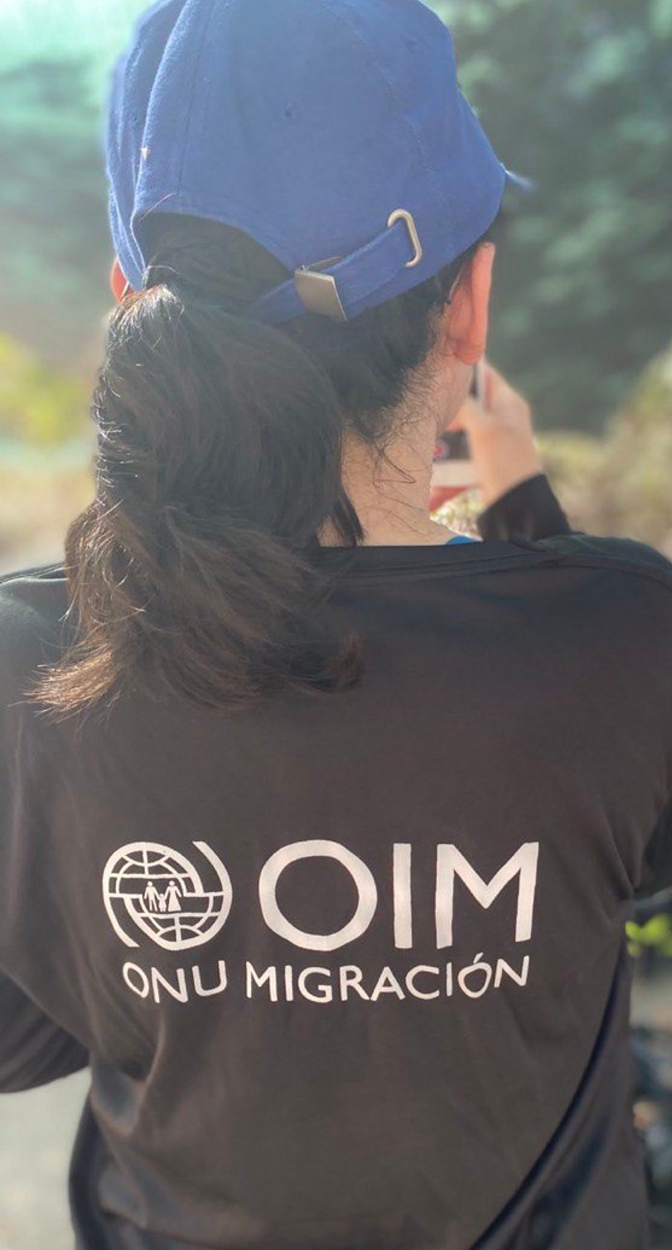
International Organization for Migration (IOM)
Established in 1951, IOM is the UN agency for Migration.
IOM works closely with governmental, intergovernmental and non-governmental partners to promote regular, safe and orderly migration for the benefit of all.
IOM has over 25 years of experience in counter-trafficking.
IOM works on all aspects of counter-trafficking responses (prevention, protection, prosecution and partnership) across humanitarian and development settings.

Slide 5
Problem Statement
Costa Rica is placed under Tier 2 according to the 2022 TIP Report ​
Previous studies have documented aspects of human trafficking and labor trafficking in Costa Rica, however: ​
No systematic empirical study has addressed the dynamics of labor trafficking within the fishing sector in the country​
No intervention has ever been conducted within this sector in Puntarenas​

Slide 6
Objective
Document the robustness of two methodological approaches in human trafficking prevalence research and identify and build the capacity of human trafficking teams in the design and implementation of human trafficking prevalence data in Costa Rica.
This project is the first of its kind in Costa Rica.

Slide 7
General description
Geographic area
Beneficiaries
Project Management
Implementation period
Counterparts
15 coastal communities of Puntarenas (Pacific Coast).
Individuals working in the Fishing industry in Puntarenas; artisanal or on a larger scale, longline, peeling, etc.
Local fishing associations and organizations.
Relevant CT stakeholders at a central and local level (ST CONATT, CCSS, INCOPESCA, Coastguard, IMAS, INAMU, MTSS, OIJ, OAPVD, PPM).
IOM Costa Rica Mission.
From June 30th, 2022, to March 31st, 2023.

Slide 8
Project Timeline
GAP Analysis
Cognitive test
Snowball surveys conducted
July-December 2022
September
2022
January-March 2023
June-August
2022
September 2022
October-December
2022
March-May 2023
Household surveys conducted
Data Analysis
Meetings with National and local counterparts
Presentation of the Project and Community Mapping

Slide 9
Context
Human Trafficking in Costa Rica
Over 400 cases of TiP victims in Costa Rica from 2010 to 2023 (ERI 2022).
Labor trafficking is the second most common purpose of the crime in the country (ERI, 2022).
Labor trafficking in the fishing sector in Costa Rica has not been studied or investigated.

Slide 10
Context
Fishing industry in Costa Rica
Predominantly composed of artisanal fishing. Total number of workers in this sector is unknown.
The fishing sector is unaware of what labor exploitation and human trafficking is.
Normalization of practices that put labor rights at risk
People in the fishing sector are forced to adopt risky survival mechanisms or participate in illegal activities (such as drug trafficking).
Articulation mechanisms between the fishing sector and local institutions are weakened.

Slide 11
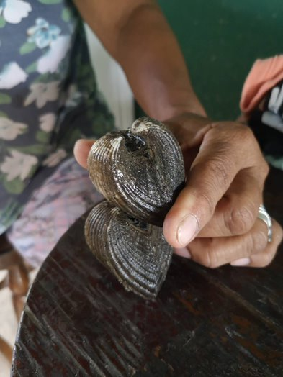
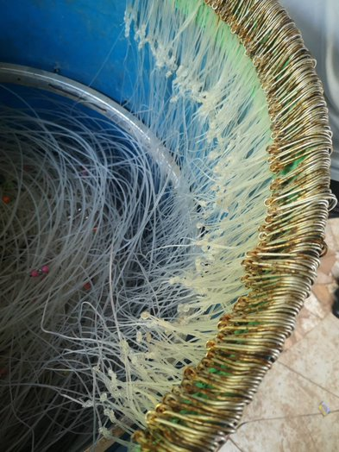
Fishing as a lifestyle
Fishing in Costa Rica is a lifestyle and a culture that contributes to coastal communities' well-being.
Every task in the fishing value chain is an essential part of the way of life of coastal communities.

Slide 12
How are fishing and human trafficking linked?
Higher rates of poverty, extreme poverty and crime
Absence of official contract terms
Lack of employment alternatives
Source: ENAHO, INEC
From 2018 to 2022 crimes in the province of Puntarenas corresponded to 11,79% of the national total. (Source: OIJ)

Slide 13
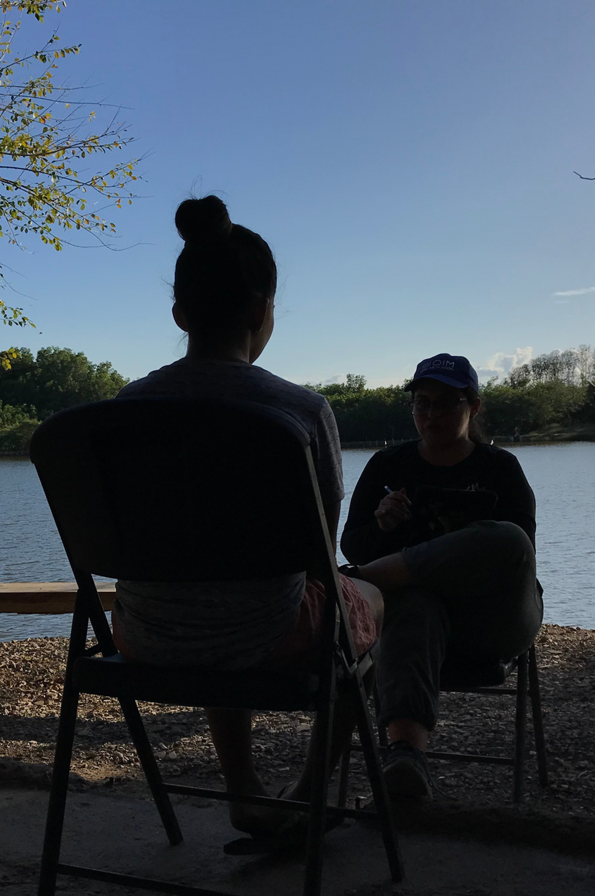
The survey
The survey explored socioeconomic and labor conditions in the fishing sector.
The IOM Data Protection and Confidentiality Principles were guaranteed.
2026 people working in the fishing sector in Puntarenas were surveyed.

Slide 14
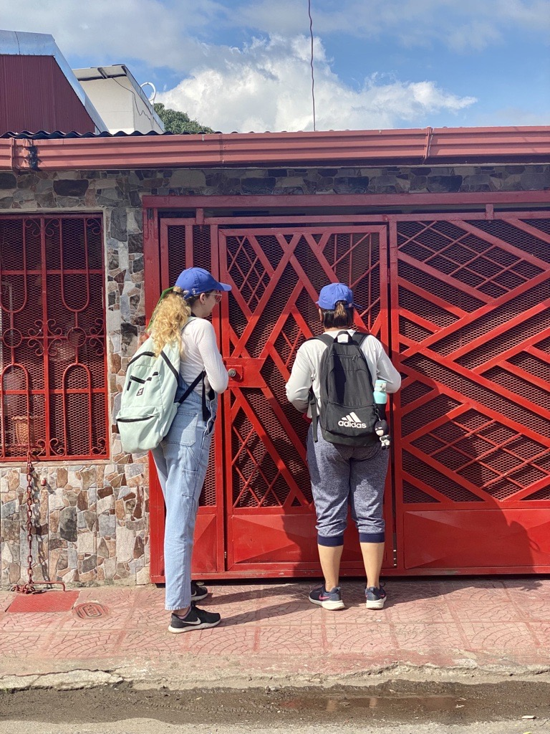
Data collection methods
Household survey (PPS)
Link Tracing Sampling /LTS)
Multi-stage probability proportionate to size (PPS)/Household enrollment sampling
.​
Multi-wave snowball/Link tracing sampling (LTS)
.​

Slide 15
PPS Process
Fieldwork Planning
Staff recruitment
Training
Pilot
Geographic analysis and distribution of the teams
Application of surveys
Cognitive Testing
Throughout the Project:
Meeting with counterparts.
Monitoring and tracking system.
Coordination with NYU.
District visits.
Security monitoring.
Monitoring and tracking System.
Coordination with NYU.
District visits.
Security monitoring.

Slide 16
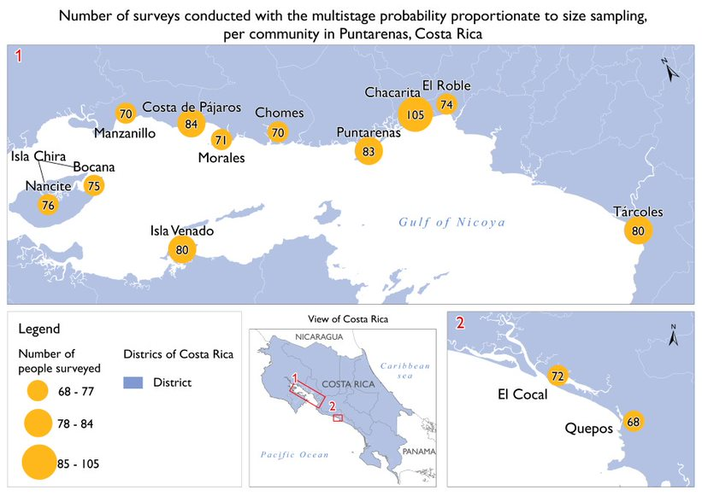
Household sample
(PPS)
1017 surveys

Slide 17
Lessons learned
Best practices
Household enrollment is incredibly challenging in tropical countries.
Use of geographic information systems (GIS) to analyze the territory.
Work in a most effective way in pairs.

Slide 18
LTS Process
Throughout the Project:
Meeting with counterparts.
Monitoring and tracking system.
Coordination with NYU.
District visits.
Security monitoring.
Training
Identification of seeds
Logistics of survey delivery
Application of surveys
Field work planning
Staff recruitment
Monitoring and tracking System.
Coordination with NYU.
District visits.
Security monitoring.

Slide 19
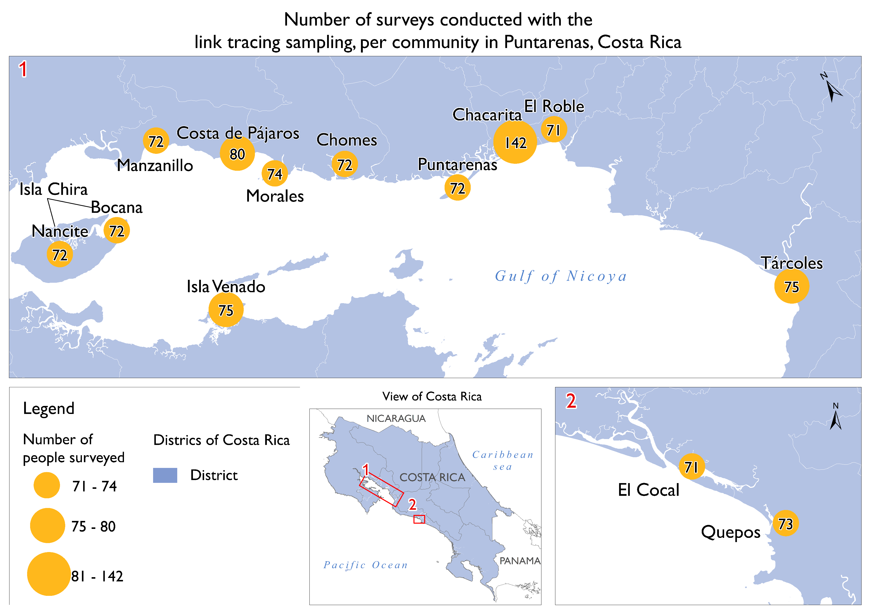
Link Tracing Sampling
(LTS)
1009 surveys

Slide 20
Lessons learned
Best practices
Continuous monitoring of the tracking sheets by field supervisors allowed an early identification of codes registration errors.
Meetings with counterparts for seed identification.
Comprehensive tracking system ensured methodologic rigor.
Use of telephone numbers to identify already-captured respondents.
Consolidating management of incentives ensured methodologic rigor.

Slide 21
LTS Coding System
Community Initials + Gender+ Reference’s name initials
Example: Puntarenas + Female + Paula Coto
PT + F + PC = PT-F-PC
Seeds
MP-S-001
1 wave
MP-R-1001
2 wave
MP-R-2001
MP-R-1002
MP-R-1003
3 wave
MP-R-2002
MP-R-2003
MP-R-3001
MP-R-3003
MP-R-3002
MP-S-002
MP-S-003
Enumerator’s Initials + S: Seed / R: Reference + Survey sequence # (pre-assigned to each enumerator)
Example: Maria Pérez + Seed + Survey 025
MP + S + 025 = MPS025

Slide 22
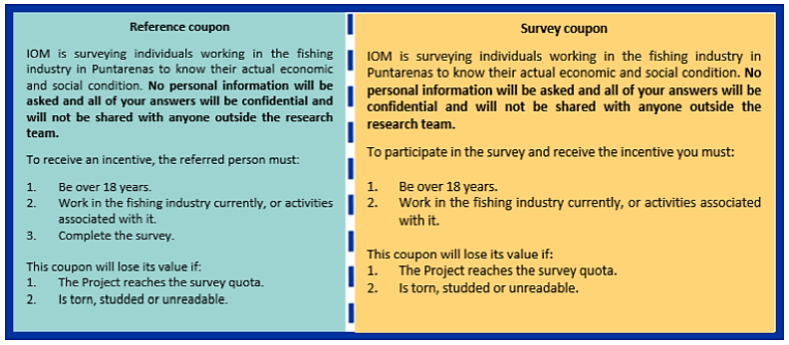
The Coupon

Slide 23
Methodological good practices from the field
Meetings with counterparts:
Buy-in.
Map security concerns.
Strategic rotation field staff:
Rigorous data collection.
Close supervision:
District visits.
Tracking system.
Clarity among team members.
Exact monitoring of the surveys.
Hiring local staff:
Favored decision-making during data collection.
Regular conversations with counterparts:
Drew attention to the importance of having evidence-based information for decision-making.

Slide 24
Incorporating IOM Protection Principles
Neutrality & Impartiality
IOM secured alliances with key counterparts from all political sides and sectors to ensure engagement.
Do no harm & No discrimination
Data Protection
Local teams trained on PFA intervention & Vicarious Trauma.
Gender Sensitivity
Informed consent from respondents.
IOM takes into account the sexual division of labor in the fishing industry.
Enumerators were trained on how to respond to GBV and TiP disclosures.
No personal data was collected.
IT equipment and programmatic tools helped kept data secured.

Slide 25
Outstanding results
What was found in the study?

Slide 26
Demographic profiles
Over 70% of respondents in both samples were between the ages of 26 and 60.
An average of 39% in both samples were women, while 60% were men (about 2/3 of the total sample).
58% of individuals surveyed reported that their highest level of education was primary school, while an average of 18% reported having no formal studies.
Around 48% of individuals surveyed indicated that they were not able to cover their household expenses in the last 6 months.

Slide 27
Working conditions in the fishing sector
An average of 75% of the individuals surveyed do not have a fishing license issued by INCOPESCA.​
More than 75% of the individuals surveyed reported that they do not receive the IMAS benefit during the closed season.​
On average, between 41-43% reported working for a boat owner; while 16% work under subcontract.​
On average, 65% of the individuals surveyed reported starting to work in fishing as minors.​

Slide 28
Migration in the fishing sector
An average of 8.75% of the sample reported being migrants (177 people).
The majority said their country of origin was Nicaragua, followed by Colombia and Venezuela.​

Slide 29
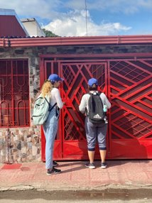
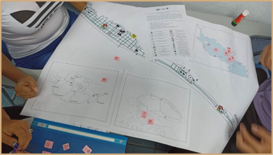
Results with “Household Survey” (PPS) methodology
Final sample of 1,017 individuals.​
Overall rate of forced labor at 21,1%

Slide 30
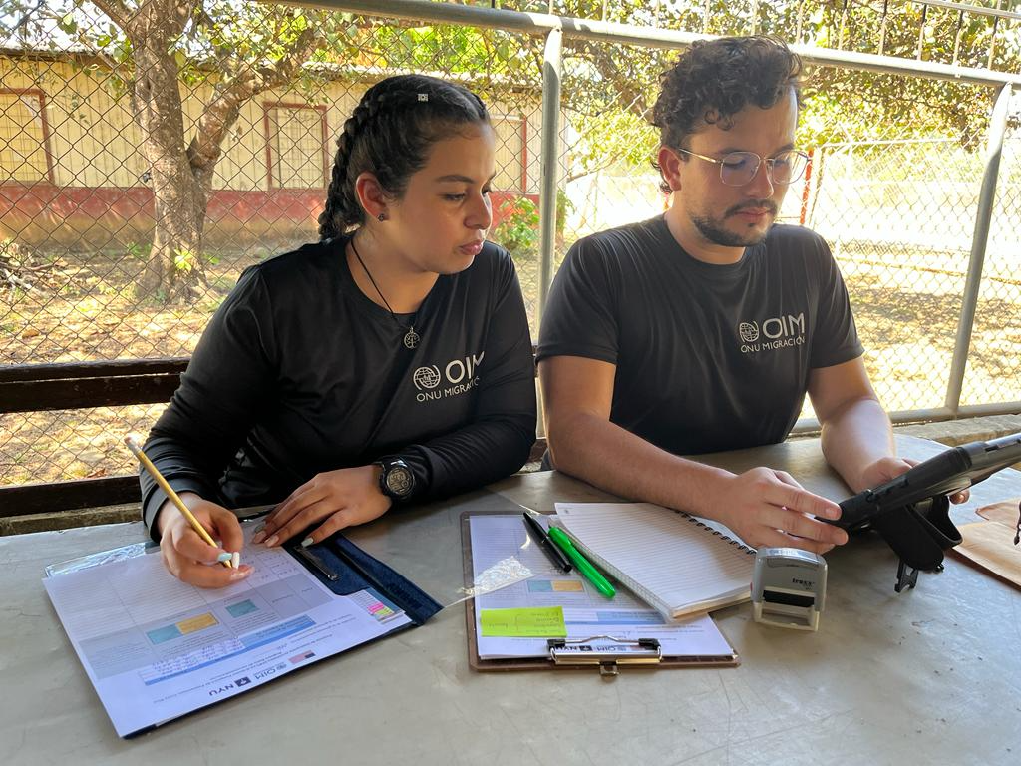
Results with “Snowball” methodology (LTS)​
Final sample of 1,009 individuals.
Overall rate of forced labor at 22,4%

Slide 31
Estimation of prevalence of forced labor in the fishing industry in Puntarenas
1 of every 5
individuals
who work in the fishing sector in Puntarenas, have experienced abuses in their workplace that could represent an indicator of human trafficking.​

Slide 32
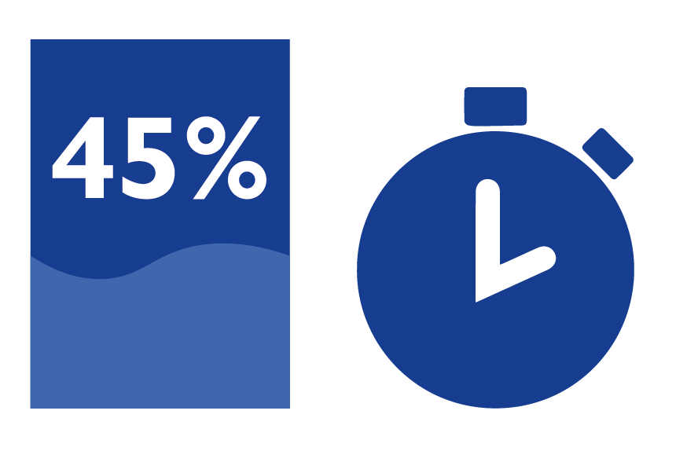
Abuses during recruitment
41% to 49% indicated that they had at some time felt forced during recruitment to accept a job.​
45% of individuals surveyed have felt deceived or lied to about the nature of the job, specific responsibilities and the number of hours worked.​
Some of these individuals happened to be kidnapped, confined or held against their will during the recruitment phase (an average of 13% in their current job and 9.75% in previous jobs).

Slide 33
Abusive employment practices and penalties
17% reported that their employer has inflated the price of expenses for fuel, boat rentals and fishing equipment.​
Over 30% have ever seen the value of the products or services provided reduced; mainly on the marine product collected.​
An average of 6% have had compensation or benefits withheld to prevent them from leaving their jobs.​

Slide 34
Personal life and property
Between 1.3% and 1.4% of both samples reported that their current employer threatened to isolate them or isolated them from their family.​
Threats to exclude them from future employment constituted the most reported abuse in terms of violations of personal life and property. More than 5% have ever experienced this type of abuse.​

Slide 35
Degrading conditions
An average of 10% reported having ever experienced working overtime without adequate pay or salary and having to be available to their employer day and night.​

Slide 36
Freedom of movement
5% had their freedom of movement restricted at some point, being kept under surveillance or their communication with friends or family restricted.​

Slide 37
Debt or dependency
An average of 10% reported having a debt imposed on them by their current employer, with amounts up to 1,576,578 CRC.​

Slide 38
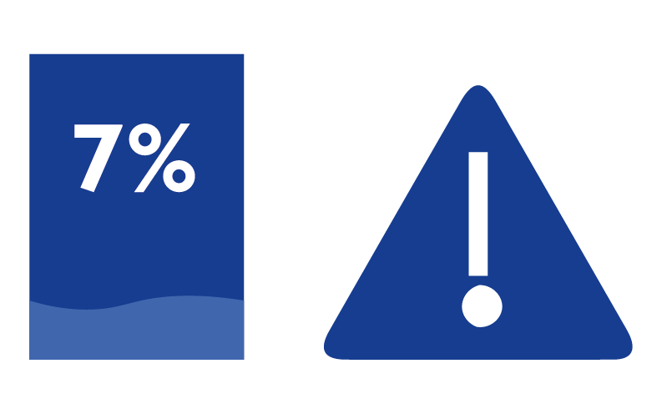
Violence and threats of violence
An average of 7% reported the use of physical violence towards them by their employer, such as pushing, shaking or throwing objects at them.​

Slide 39
Help-seeking behavior
An average of 84% declared that they had not left their jobs despite experiencing abuse, due to not having better job options.​
Only 23% on average sought help after experiencing an abusive situation in their workplace. Mainly through their work colleagues, friends or family.​

Slide 40
Risk/Protective factors
Factor
Likelihood of being victimized
Finanzas familiares: Were not able to cover houshold expenses in the last 6 months.
1,9 times more likely to experience abuse in their workplace.
Government subsidy: Do not receive the IMAS benefit (veda).
1,9 times more likely to experience abuse in their workplace.
5,3 times more likely to experience abuse in their workplace.
Children: 3 or more children.
Fishing license: Do not know or decide not to say.
3,6 times more likely to experience abuse in their workplace.
Intermediary or subcontractor: Work for an intermediary or subcontractor.
3,5 times more likely to experience abuse in their workplace.
Gender: Identify themselves as men.
2,4 times more likely to experience abuse in their workplace.

Slide 41
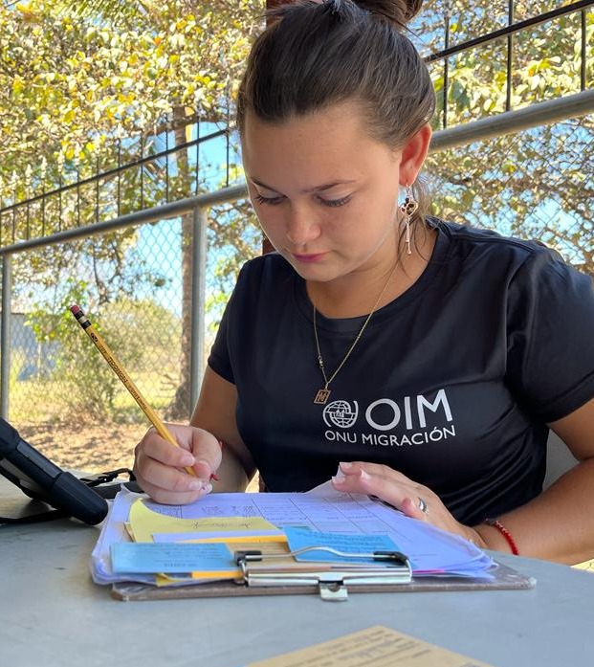
Methodological conclusions
For both thresholds of the type of trafficking studied, similar results were obtained; although for Threshold 1, which included more rigorous criteria, lower occurrence rates were recorded than for Threshold 2.​
Regarding the prevalence rate of forced labor victimization, both sampling strategies appear capable of detecting violations among the target population; yielding somewhat similar findings.​
The “Snowball” method successfully identified the most difficult-to-reach subpopulations, such as migrants and various fishing sectors.​

Slide 42
General conclusions
Practices that put at risk the labor rights and human rights of workers in the fishing sector are perceived as "normal" within the sector.​
Being the first study of this nature and design (direct comparison of 2 sampling methodologies) in the field of TIP research, it places Costa Rica in a better position for studies of a similar nature in the future.​
The majority of individuals surveyed began working in the fishing industry as minors, which illustrates the need to work specifically with boys and girls, and their families and communities, in Puntarenas.​
People in the fishing sector often adopt risky survival mechanisms and even participate in illegal activities.​

Slide 43
Recommendations
Use evidence-based information to develop strategies to prevent and address human trafficking at the local and national level.​
Carry out awareness and information campaigns to increase knowledge about the legal protections and rights of workers in the fishing sector and the routes for reporting and referring cases of rights violations.​
Strengthen communication, articulation and coordination mechanisms between people who work in the fishing sector and local institutions to address situations of abuse, exploitation and human trafficking, among other human rights violations.​
Implement referral systems for cases of abuse, exploitation and trafficking in persons that already exist at the national and local level, and create them when they do not exist.​
Strengthen central-local coordination between actors involved in the fight against human trafficking.​

Slide 44
Where we are now...
PHASE 2:
Data Analysis
PHASE 3: Results presentation
PHASE 4:
Community actions
PHASE 1: Surveys
2023-2026

Slide 45
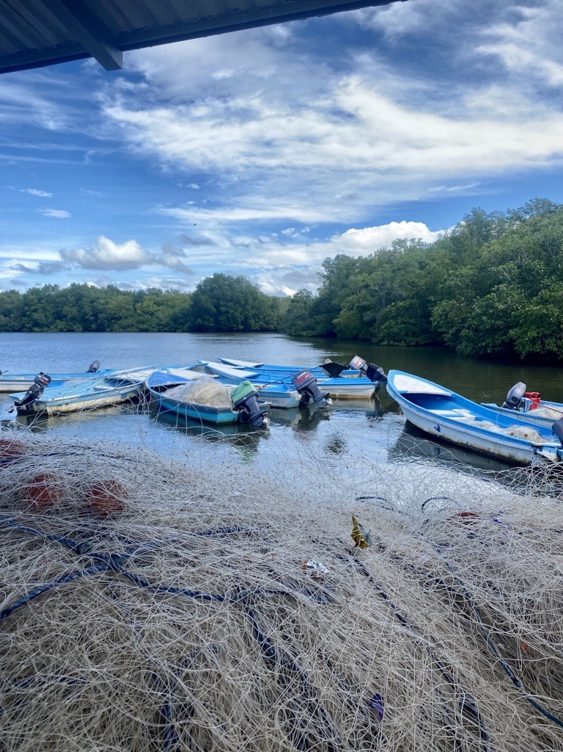
El ser humano no está a la venta.

Slide 46
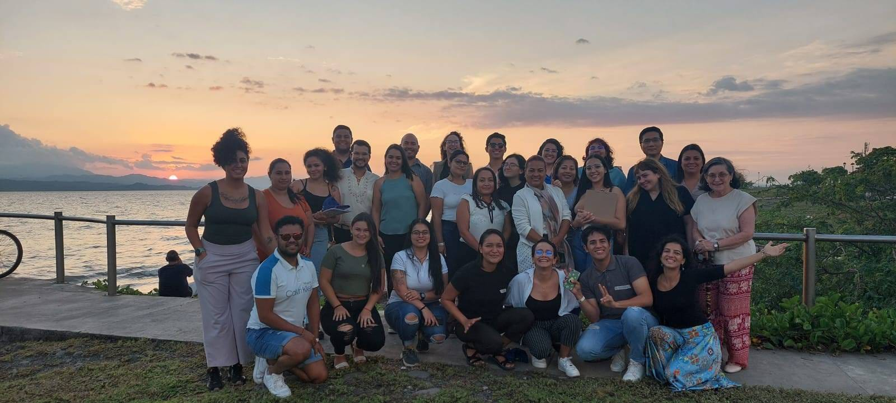
Thank you
Francesca Tabellini - Project Manager | Alina Cedeño – Project Assistant
Jostin Hernandez - Administrative Assistant | Jazmín Vega Valerín – Field Supervisor
Celin Guevara Cortéz | Enyell Valerio Carranza | Felipe Duarte Villanueva | Freyser Rojas Castro | Grace Rodríguez Agüero | Graciela Barrantes Fuentes | Greylin Navarro Castro | Ingrid Aguilar Zúñiga | Jarod López Gutiérrez| Kendy Corrales Rodríguez Kenneth Chaves Morales | Marcela Ledezma Araya | Mariana Barboza Pérez | Mariana Barrios Martínez | Mariang Camareno Ramírez | Maureen Porras Arias | Nathalie Valverde Araya | Paulina Ramírez Solís | Priscilla Fernández Mora | Sharlin Marín Jiménez | Sugeidy Ponce Torres

